Slide 1
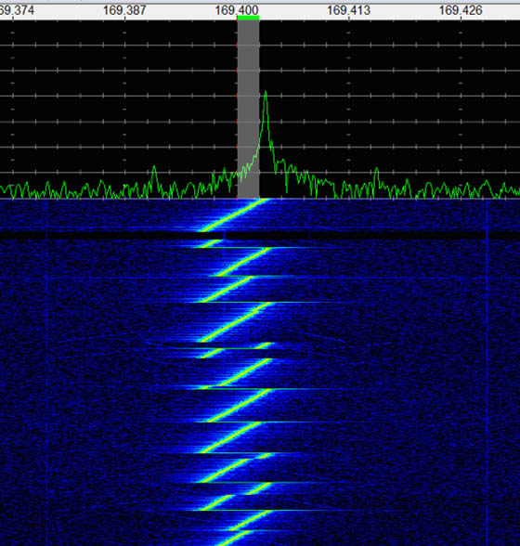
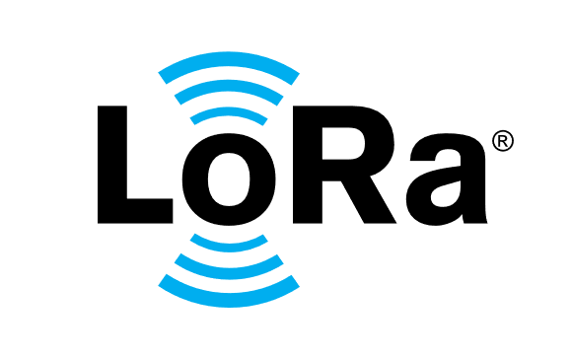
LoRa
By Kyle Plant
Notes:
Hello. This is my individual technical presentation for Capstone 2. I will be talking about LoRa.

Slide 2
What is LoRa?
Physical layer modulation technique
Stands for Long Range
Underlying modulation scheme behind LoRaWAN (Network layer)
Operates at the 915 MHz ISM band in the US region
Provides long range, low power consumption, low data rate, and affordable communication
Max range achieved: 1336 km / 830 miles (on the sea)
Data rates from 0.3 kbit/s to 27 kbit/s
Great for IoT applications
Notes:
First I should define what LoRa is. LoRa is a physical layer modulation technique. It stands for Long Range. LoRa is the physical layer modulation scheme behind the LoRaWAN network layer protocol. LoRa operates at different frequencies depending on your region but here in the US we use it at the 915 MHz ISM band. LoRa provides long range of course, low power consumption and low data rate relative to something like WiFi, and LoRa is very affordable, cheap devices can work with LoRa. Just some fun facts, the max range achieved by LoRa is 1336 km or 830 miles across the sea. And you can expect data rates from about 0.3 kbit/s to 27 kbit/s. These attributes make LoRa a great choice for IoT applications like transmitting sensor data every now and then.

Slide 3
History of LoRa
Invented in 2009 by Nicolas Sornin, Olivier Seller, and François Sforza. They founded Cycleo together.
They were interested in the metering industry and aimed at adding wireless communication to gas, water, and electricity meters.
They used Chirp Spread Spectrum modulation technology.
CSS was already widely used for sonar and radar. Also, dolphins and bats use similar chirps to detect fish or insects!
Cycleo however initiated the use of CSS for sending data.
Cycleo acquired by Semtech in May 2012.
Semtech with IBM created the LoRaMAC protocol.
The LoRa Alliance was founded in 2015 and LoRaMAC was renamed LoRaWAN. Open, non-profit. Goal to promote adoption of LoRaWAN.
Notes:
A little history lesson on LoRa.

Slide 4
Benefits of LoRa
Chirp Spread Spectrum modulation allows signal decoding when it’s completely sunk in noise. The ability to demodulate below the noise floor helps give the trademark long range of LoRa.
Incredible range for how cheap it is to use.
Low power usage.
Widely used and supported for IoT. TTN, ChirpStack, etc.
Computationally simple signal processing
Flexibility, configurability
Notes:
Some of the benefits of LoRa include its’ modulation technique, Chirp Spread spectrum modulation, which allows signal decoding when it’s completely sunk in noise. That ability to demodulate below the noise floor helps give LoRa its’ long range.

Slide 5
Shortcomings of LoRa
Data rate maxes out at around 27 kbit/s
High latency

Slide 6
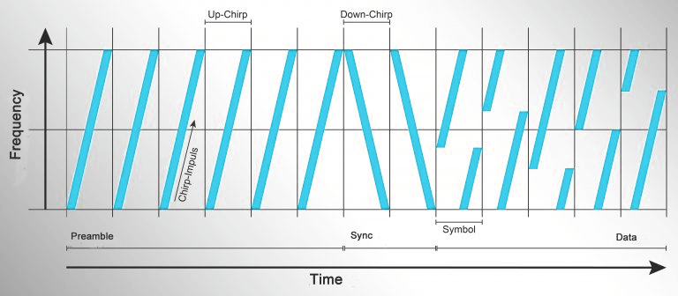
LoRa Modulation
Chirp Spread Spectrum Modulation.
A chirp is a signal where frequency increases or decreases with time.
CSS modulation takes the 1s and 0s of the data you want to send and converts them into a set of chirps made up of distinct symbols.
Up-chirps increase in frequency, down-chirps decrease.
Notes:
Now, what is Chirp spread spectrum modulation? So first of all a chirp is..

Slide 7
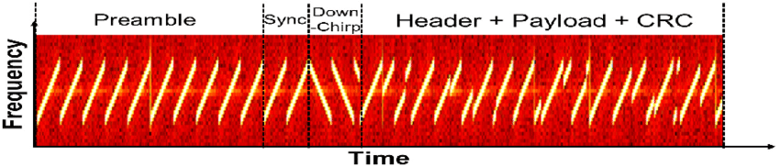
LoRa Frames
Every line is a single chirp. The chirp sweeps over a range of frequencies over time.
Preamble, sync word, data (and CRC).
The Preamble and sync word get the attention of the receiver. They are easy to detect.
Data is the part that is modulated. Frequency-time profile defines symbol value.

Slide 8
LoRa Configuration
Based on your application you can choose which balance of these are best for you.
Need more range, more bandwidth, less time on air for saving battery power?
Bandwidth
Spreading Factor
Coding Rate
Data Rate, determined by the previous

Slide 9
LoRa Configuration - Bandwidth
The rate a signal changes. Defines the maximum amount of information that can be communicated per unit of time.
Uses units: Hz
Commonly used bandwidths are 125 kHz, 250 kHz, and 500 kHz.
High quality radios with TCXOs can get even lower for extreme range. As low as 7.8 kHz.
Rule of thumb:
The higher the bandwidth, the higher the data rate.
The lower the bandwidth, the lower the data rate.

Slide 10
LoRa Configuration – Spreading Factor
The ratio between the bandwidth and the data rate.
Commonly used SFs are SF7 to SF12
Determines the speed at which the chirp is swept across the frequency range.
Affects time on air.
Higher SF, higher time on air, consequently more power draw, vice versa.
Higher spreading factors help increase the range because they can be demodulated further below the noise floor than lower spreading factors.
Increasing the SF by 1 halves data rate for fixed bandwidth, vice versa.

Slide 11
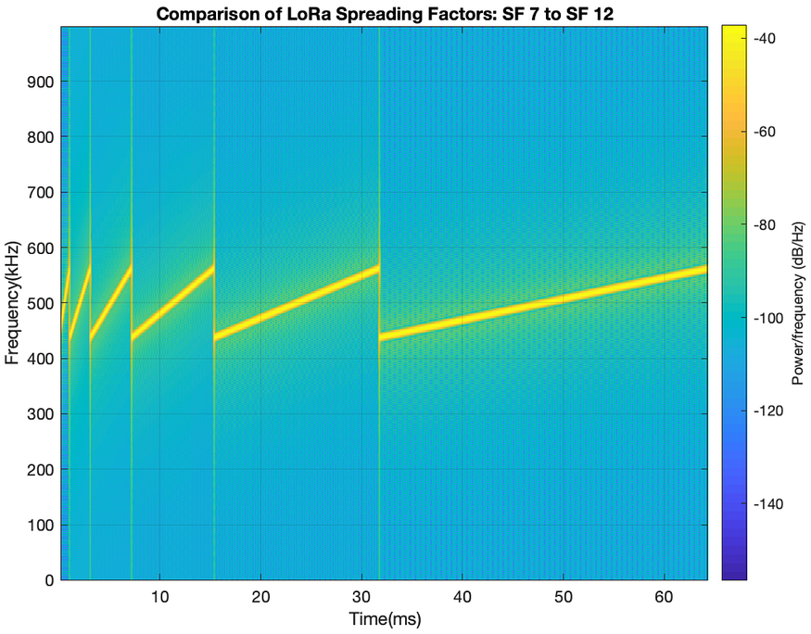
LoRa Configuration – Spreading Factor

Slide 12
LoRa Configuration – Coding Rate
Defines the efficiency of error-correcting codes.
Represented by a ratio of the information bits to the total number of bits transmitted.
Commonly set to 4/5 because LoRaWAN fixes the coding rate to 4/5.
The redundant bits allow the receiver to recover from demodulation errors.
CRC – cyclic redundancy check.
Higher number of redundant bits, lower data rate, and higher resiliency to errors, vice versa.

Slide 13
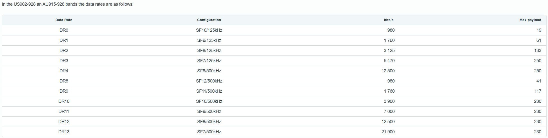
LoRa Configuration - Summary
From: https://www.lab5e.com/docs/lora/dr_sf/

Slide 14
LoRa Frame MATLAB example
There is a great MATLAB script that can generate LoRa frames and display them on a spectrogram!
Credit: B. Al Homssi, K. Dakic, S. Maselli, H. Wolf, S. Kandeepan, and A. Al-Hourani, "IoT Network Design using Open-Source LoRa Coverage Emulator," in IEEE Access. 2021.

Slide 15
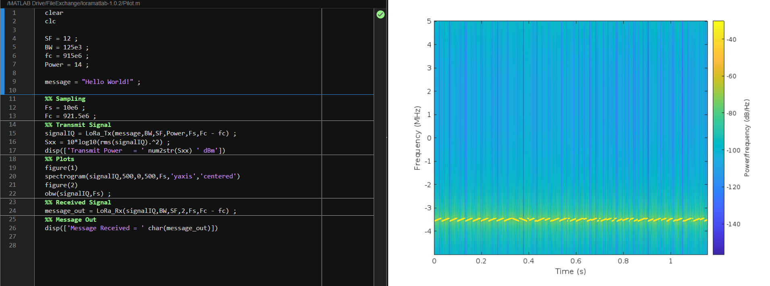
LoRa Frame MATLAB example

Slide 16
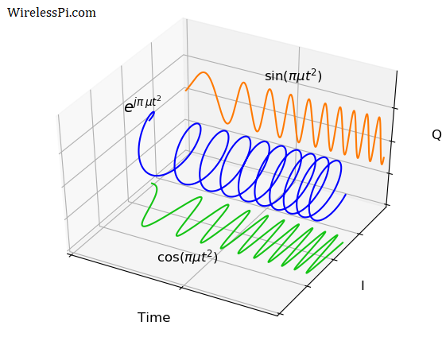

Math Underlying LoRa CSS Modulation - Symbols
Where SF is Spreading Factor (7-12)
The number of symbols is 2^{SF}
So the symbols are S = 0, 1, 2 … 2^{SF}-1
SF means bits per symbol, ex. SF7 has 7 bits per symbol
From Euler’s relation, cos is real sin is imaginary.
General expression for a chirp’s instantaneous frequency where Phase is $θ$, Frequency is $ω=2πf$, and Chirp rate is $μ$:
$x\left(t\right)=e^{j(πμ^{2}+2πft+θ)}$
Notes:
The chirp is complex at baseband

Slide 17

Math Underlying LoRa CSS Modulation - Symbols
How to form each symbol:
Where s is the symbol number (like the starting point of the chirp), T_{s} is the symbol duration, T is the sample duration, SF is spreading factor, k increments on each sample, it is a frequency. Modulo rolls the instantaneous frequency roll back to the lowest frequency when the bandwidth limit $2^{SF}$is reached, produces discontinuity you can see in the chirp spectrographs.
End frequency of a chirp will be the same as the start frequency.
$c\left({nT}_{s}+kT\right)= \frac{1}{\sqrt{2^{SF}}}e^{j2π\left(\left(s\left(nT_{s}\right)\right)+k\right)mod 2^{SF})\frac{k}{2^{SF}}}$

Slide 18
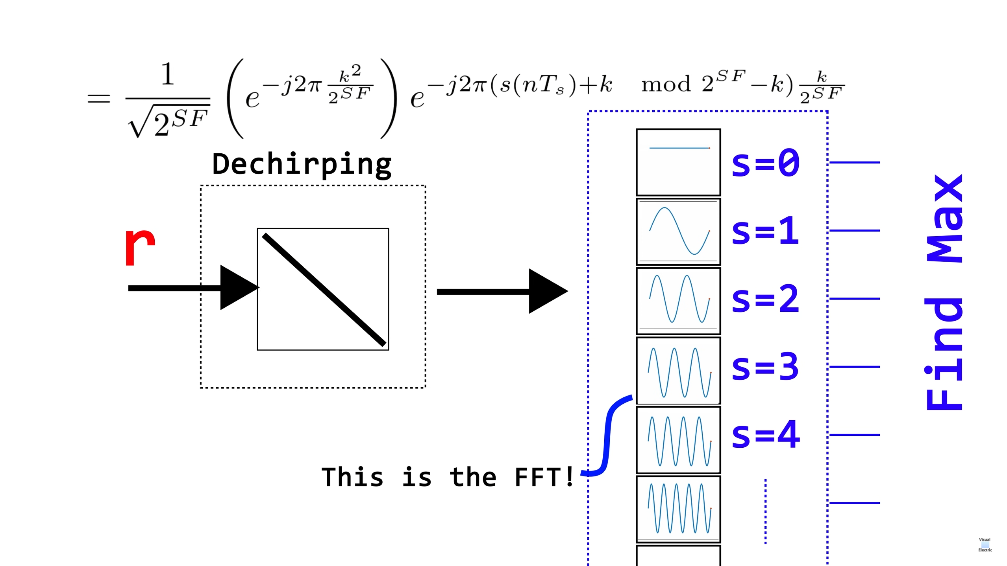
Math underlying LoRa CSS Modulation - Demodulation
The receiver will get the strength of similarity of the received signal to each of the known basis symbols (r) and multiply that by a downchirp. Known as dechirping.
Then perform the correlation with the bank of frequencies that depend on s. Equivalent to FFT. Find max correlation to determine symbol.

Slide 19
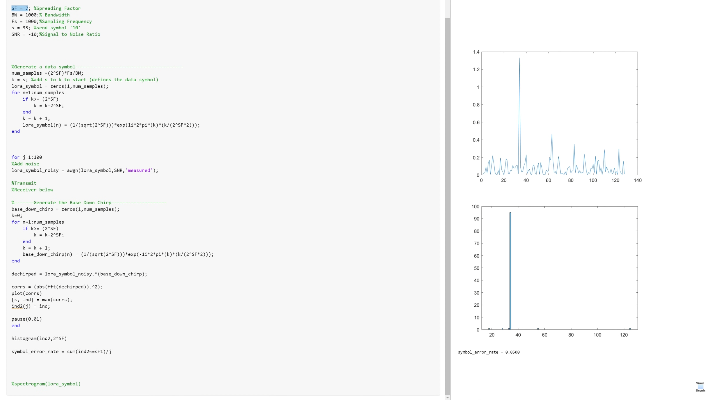
MATLAB Example: https://www.youtube.com/watch?v=jHWepP1ZWTk

Slide 20
Thank You!

Slide 21
References
LoRa world record: https://www.thethingsnetwork.org/article/new-lora-world-record-1336-km-830-mi#:~:text=The%20long%20term%20LoRaWAN%C2%AE,on%20the%20Sesimbra%20coast%2C%20Portugal.
LoRa History: https://blog.semtech.com/a-brief-history-of-lora-three-inventors-share-their-personal-story-at-the-things-conference#:~:text=The%20story%20of%20LoRa%20began,the%20idea%20into%20a%20reality.
MatLab code: B. Al Homssi, K. Dakic, S. Maselli, H. Wolf, S. Kandeepan, and A. Al-Hourani, "IoT Network Design using Open-Source LoRa Coverage Emulator," in IEEE Access. 2021. Link on IEEE: https://ieeexplore.ieee.org/document/9395074 Link on researchgate: https://www.researchgate.net/publication/350581481_IoT_Network_Design_using_Open-Source_LoRa_Coverage_Emulator

Slide 22
References
https://wirelesspi.com/understanding-lora-phy-long-range-physical-layer/
https://www.youtube.com/watch?v=jHWepP1ZWTk
L. Vangelista, "Frequency Shift Chirp Modulation: The LoRa Modulation," in IEEE Signal Processing Letters, vol. 24, no. 12, pp. 1818-1821, Dec. 2017, doi: 10.1109/LSP.2017.2762960.

